Slide 1
DiskANN: Fast, Accurate Billion Point Nearest Neighbor Search on a Single Node
Suhas J Subramanya* (CMU)
Devvrit* (UT Austin), Rohan Kadekodi* (UT Austin),
Ravishankar Krishnaswamy, Harsha Simhadri
Microsoft Research India
*work done while at MSR India

Slide 2
DL-based search needs nearest neighbor computation
Doc
Doc
Embed (offline)
Doc
Doc
Doc
Doc
Doc
Doc
Doc
Doc
Embed (online)
Query
4 nearest neighbors
Goal: retrieve the k-nearest neighbors of query as quickly as possible
Database
N = 1 (or 10 or 1000) billion points
R^{d} d~100

Slide 3
Metrics
Indexing (offline)
Time to build the index
Space requirement of index
Search Performance (online, machine dependent)
Recall (accuracy of returned results compared to true k-nearest neighbors)
Latency per query
Throughput
Proxy search metrics (machine independent)
Distance comparisons/query
Disk reads/query

Slide 4
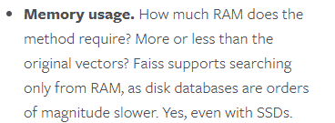
Expert opinion…
… hmm…

Slide 5
State of the art
Compression based methods (FAISS)
Data vectors are compressed to 16 or 32 bytes so 1B points fit into 32 GB RAM
Cluster dataset using k-means into ~10000 clusters
At query time, search closest 100 clusters to query using compressed vectors
Use GPU and large query batches for good throughput
Graph based methods (NSG, HNSW)
Graph built over base points
Greedy search used at search time starting at some root, and traversing neighbors till we are at local optimum
Design indexing algorithms that generate navigable graphs
Q: Can we get the best of both worlds?
High density of points/machine
Low recall 1@1, Decent recall 1@100
High recall and low latency
Low density, need 10s of machines per 1B points

Slide 6
Our Results
DiskANN and Vamana: a simple, intuitive graph algorithm algorithm that can build and serve a DiskANN index of 1B points in 100s of dimensions on machine with 64GB RAM, and get ~95 recall-10@10 with <5ms latency
FAST IN-MEMORY SEARCH: As good as best-in-class algorithms such as NSG and HNSW
FASTER INDEXING: Indexes 2-3x faster than NSG with 3-4x fewer resources (no GPUs, etc.)
MORE SCALABLE: Enables a divide-and-conquer strategy to build indices over billion points, Enables storing index on SSD to search with low latency and high recall

Slide 7
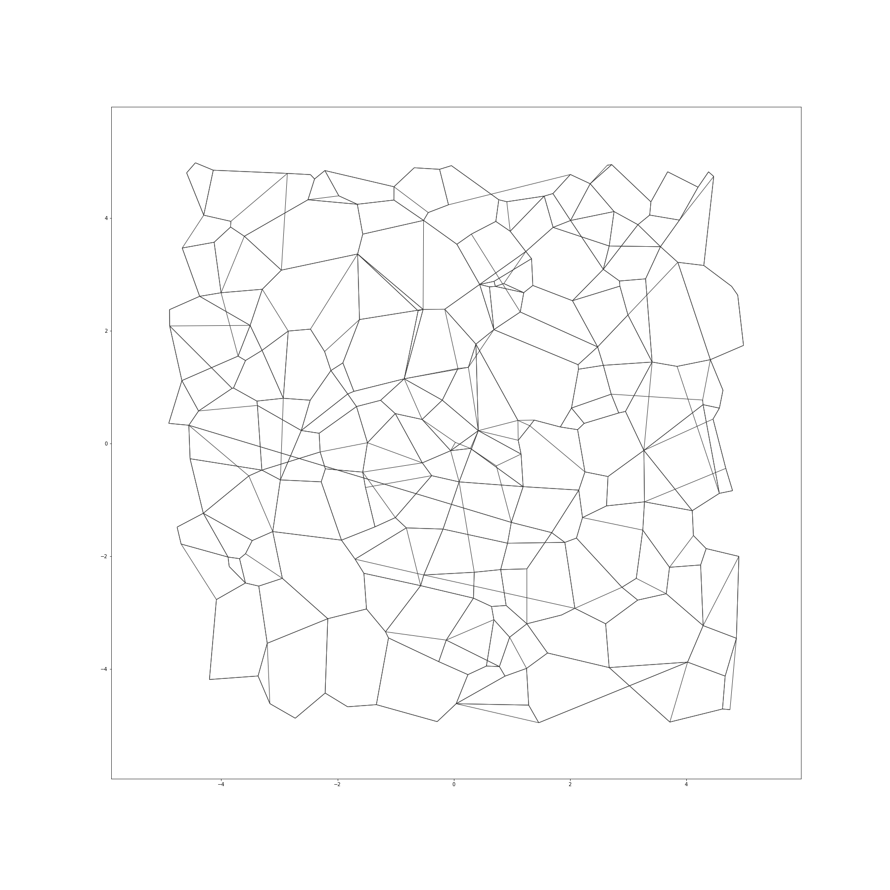
Graph-based ANNS: Quick Primer
Best-in-class solutions for several datasets
Offline Stage:
Build a graph over base points, and designate a node s as start.
Online Stage:
For query q, start at a root vertex, traverse the edges as long as distance to q improves
NSG [github.com/ZJULearning/nsg]
HNSW [https://github.com/nmslib/hnswlib]
s
q

Slide 8
Two questions relevant for us
Q1
What’s a good graph which gets us to the nearest neighbor as quickly as possible while also being sparse?
Q2
If we want to store the graph on an SSD, how do we make the number of hops as small as possible?

Slide 9
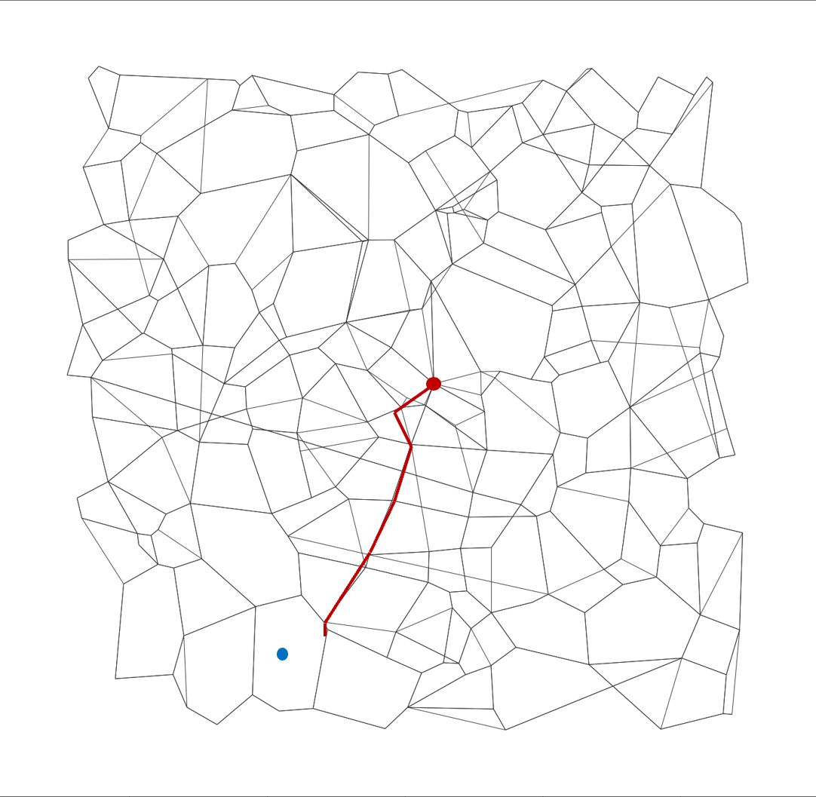
Vamana: Algorithm Overview
Vamana(R) will output a navigable graph of maximum out-degree R
initialize G to be a random graph of degree 32
pick a base point v in a random order
run GreedySearch(v) from some fixed root node r, and let Visited(v) denote the set of vertices visited in the Search algorithm
for all w in Visited(v)
run AddAndPrune(v, w)
run AddAndPrune(w,v)
repeat (until we make 2 passes on all points)

Slide 10
Determining Out-Edges Carefully: AddAndPrune(u,v)
w₃
w₁
AddAndPrune(u,v) will update out-neighbors of v by trying to add (u,v)
w₂
w₄
let Candidate(u) be current out-neighbors, Result(u) = empty
add v to Candidate(u)
sort all w in Candidate(u) by increasing distance to u
for each w in sorted order, do
if there does not exist any r in Result(v) s.t ||r – w || < α || u – w ||
u
w₅

Slide 11
Determining Out-Edges Carefully: AddAndPrune(u,v)
AddAndPrune(u,v) will update out-neighbors of v by trying to add (v,w)
r
w
let Candidate(u) be current out-neighbors, Result(u) = empty
add v to Candidate(u)
sort all w in Candidate(u) by increasing distance to u
for each w in sorted order, do
if there does not exist any r in Result(v) s.t ||r – w || < α || u – w ||
add w to Result(u)
until |Result(u) < R|
update graph and set out-neighbors of u as Result(u)
u

Slide 12
Vamana : Algorithm Overview
Vamana(R) will output a navigable graph of maximum out-degree R
initialize G to be a random graph of degree 32
pick a base point v in a random order
run GreedySearch(v) from some fixed root node r, and let Visited(v) denote the set of vertices visited in the Search algorithm
for all w in Visited(v)
run AddAndPrune(v, w)
run AddAndPrune(w,v)
repeat (until we make 2 passes on all points)

Slide 13
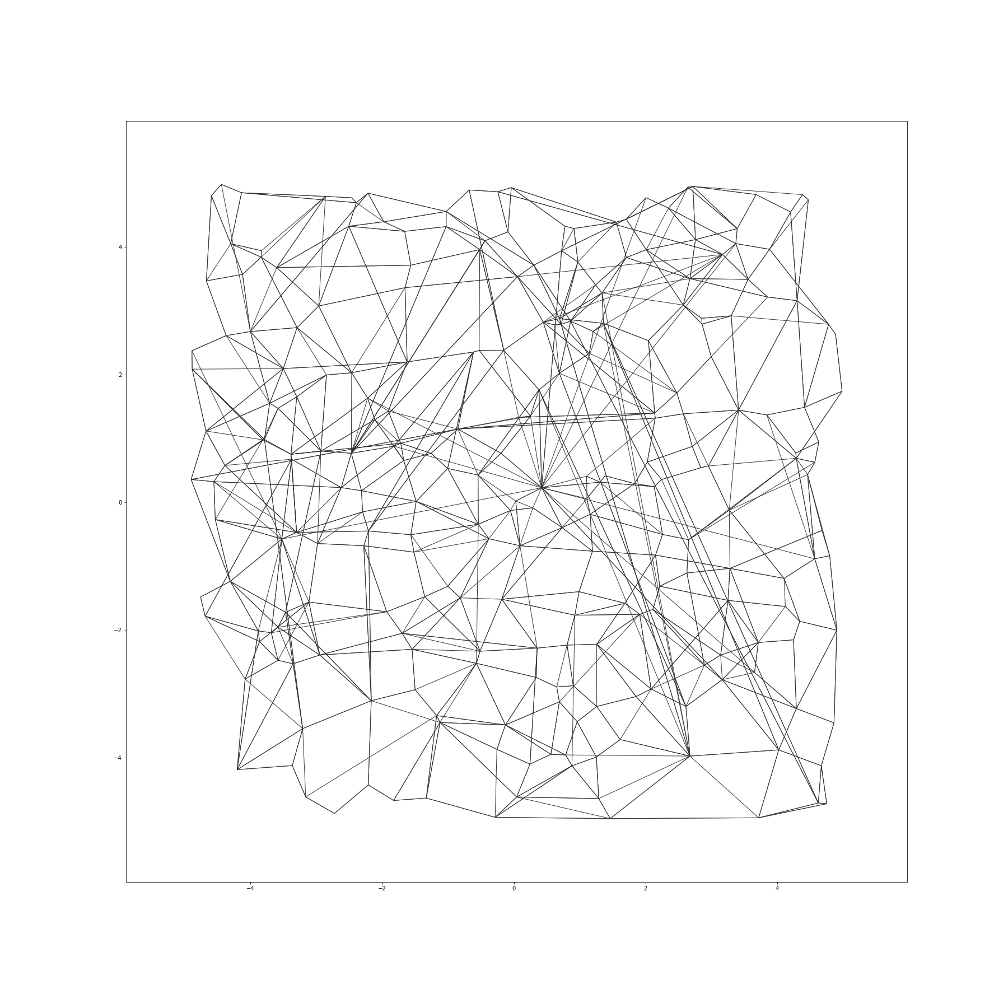
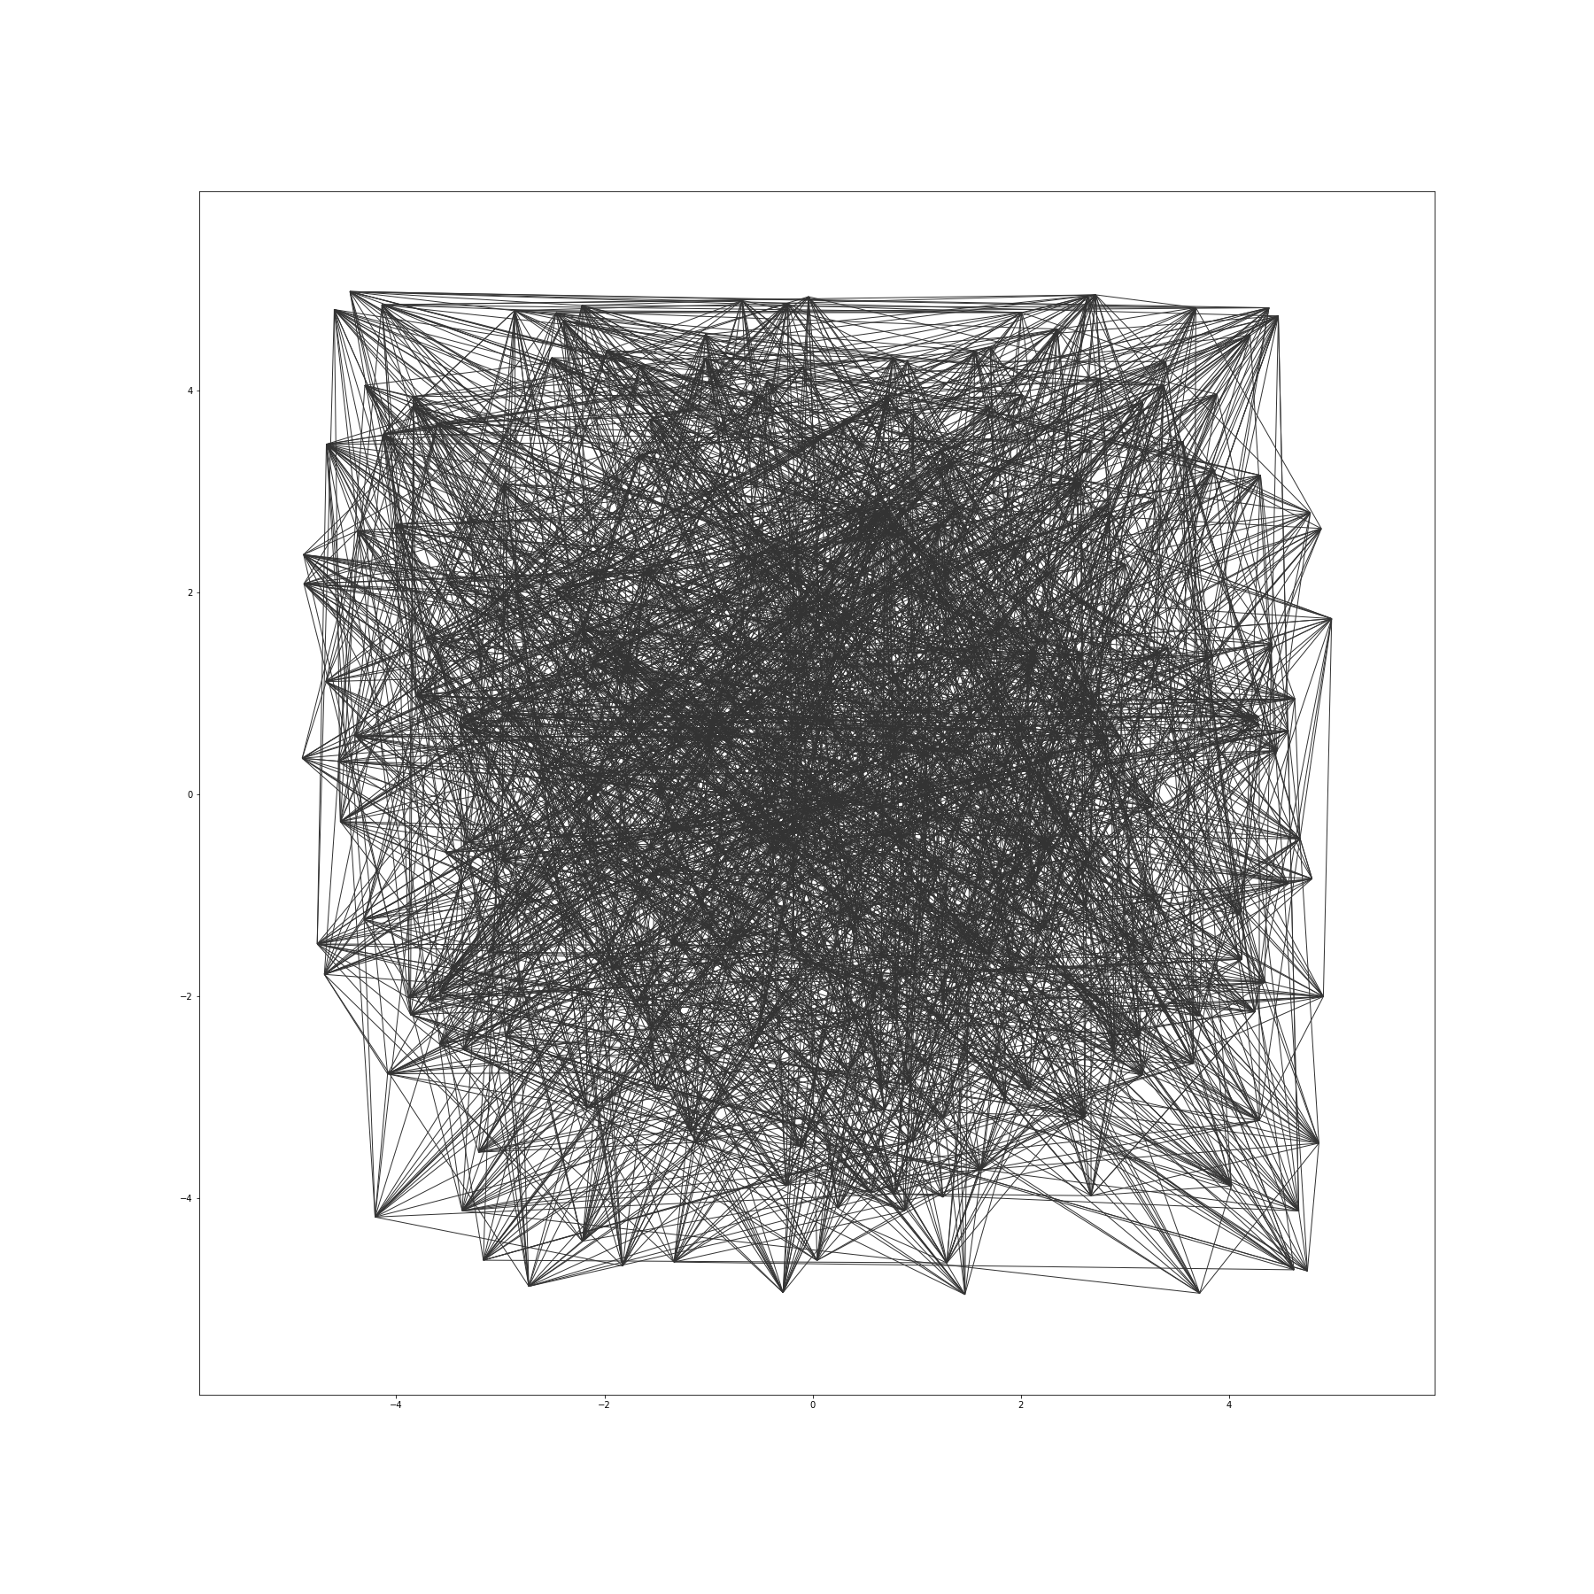
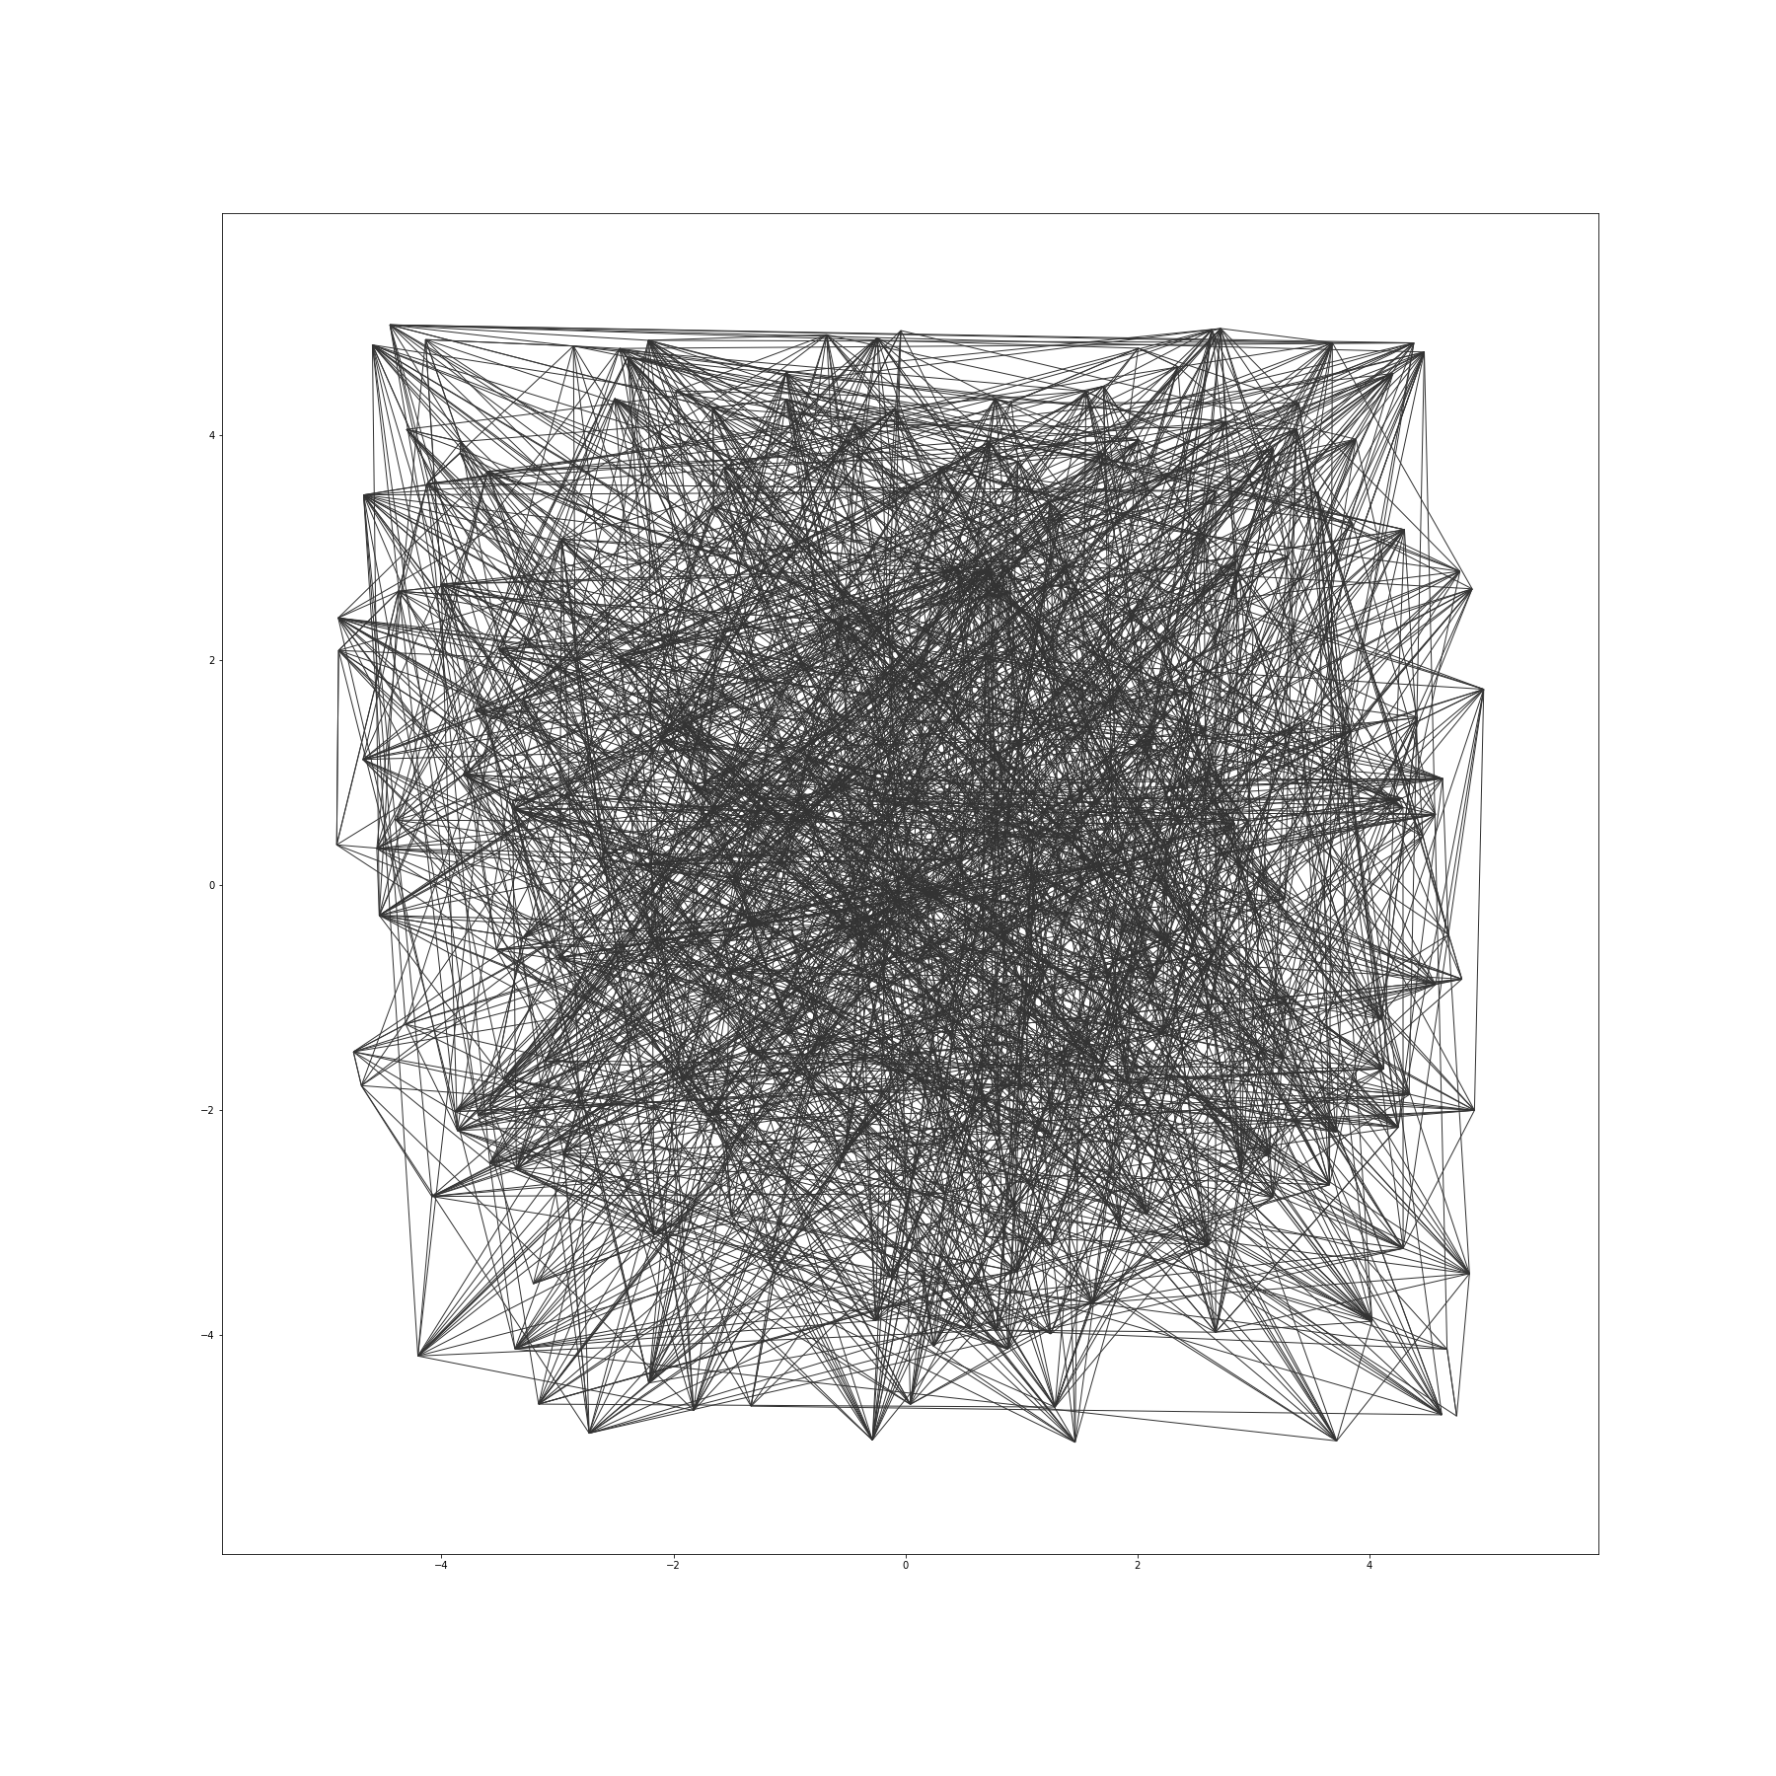
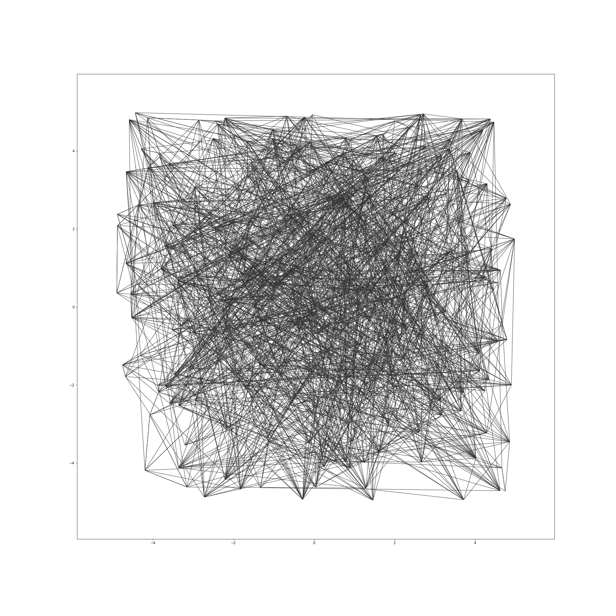
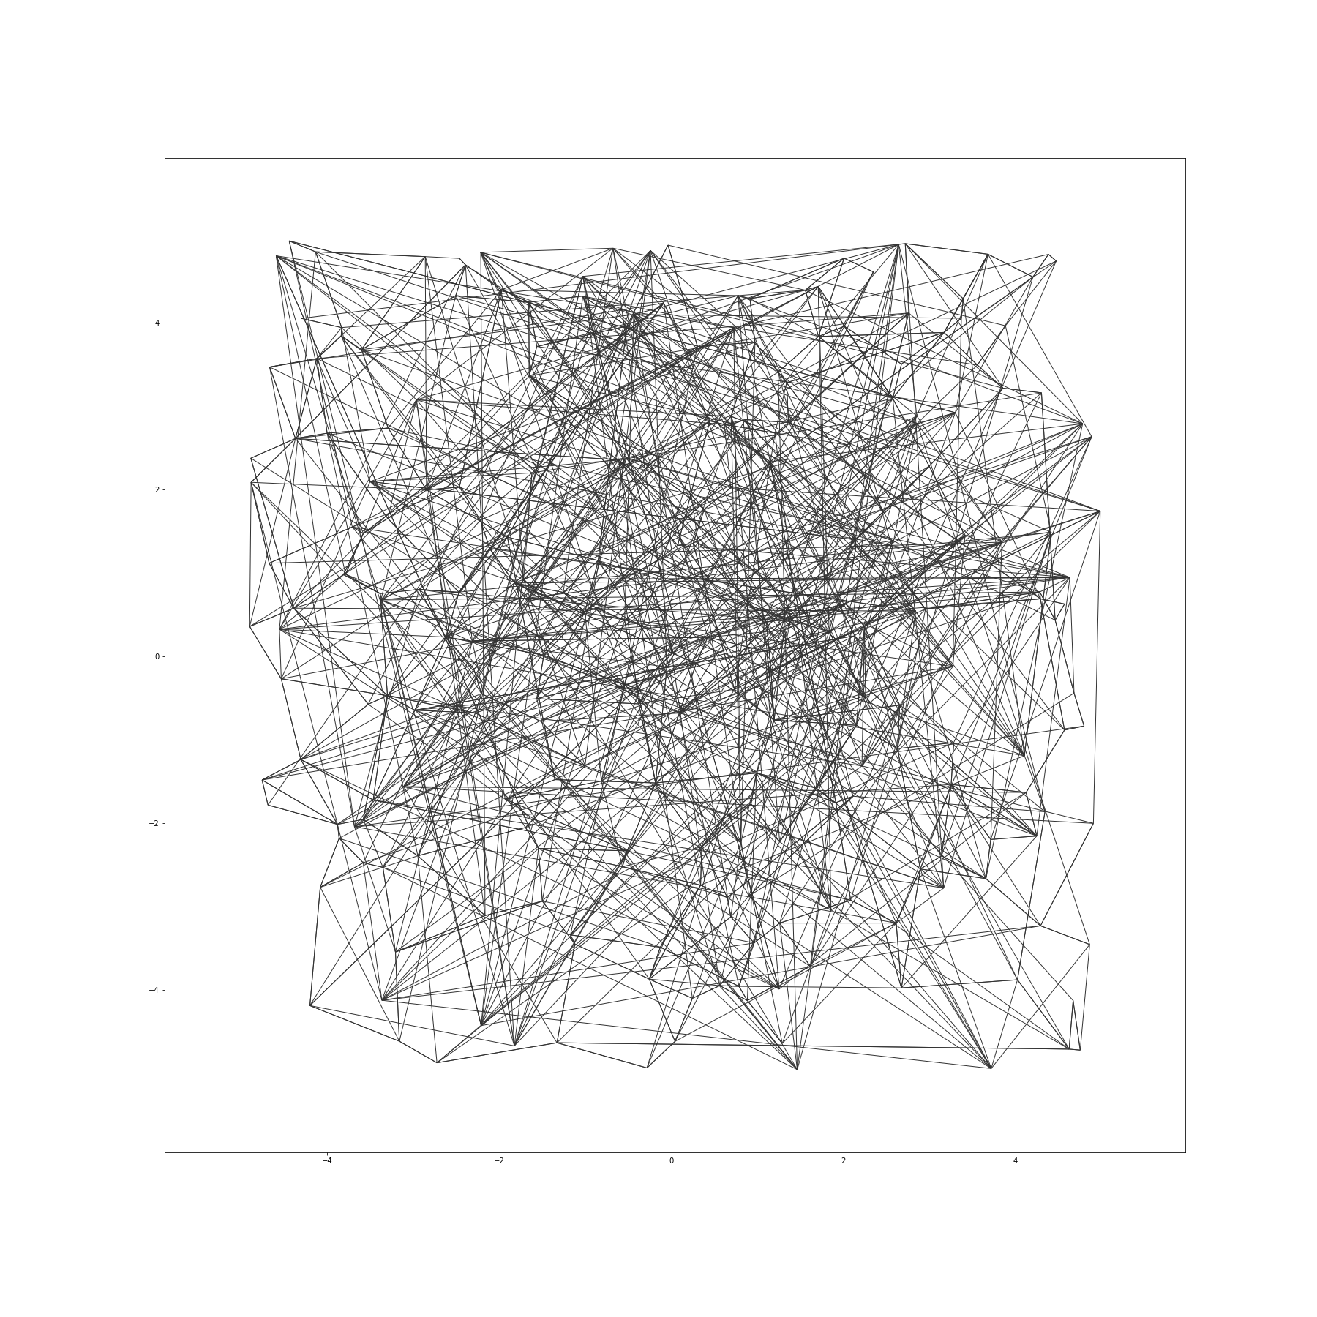
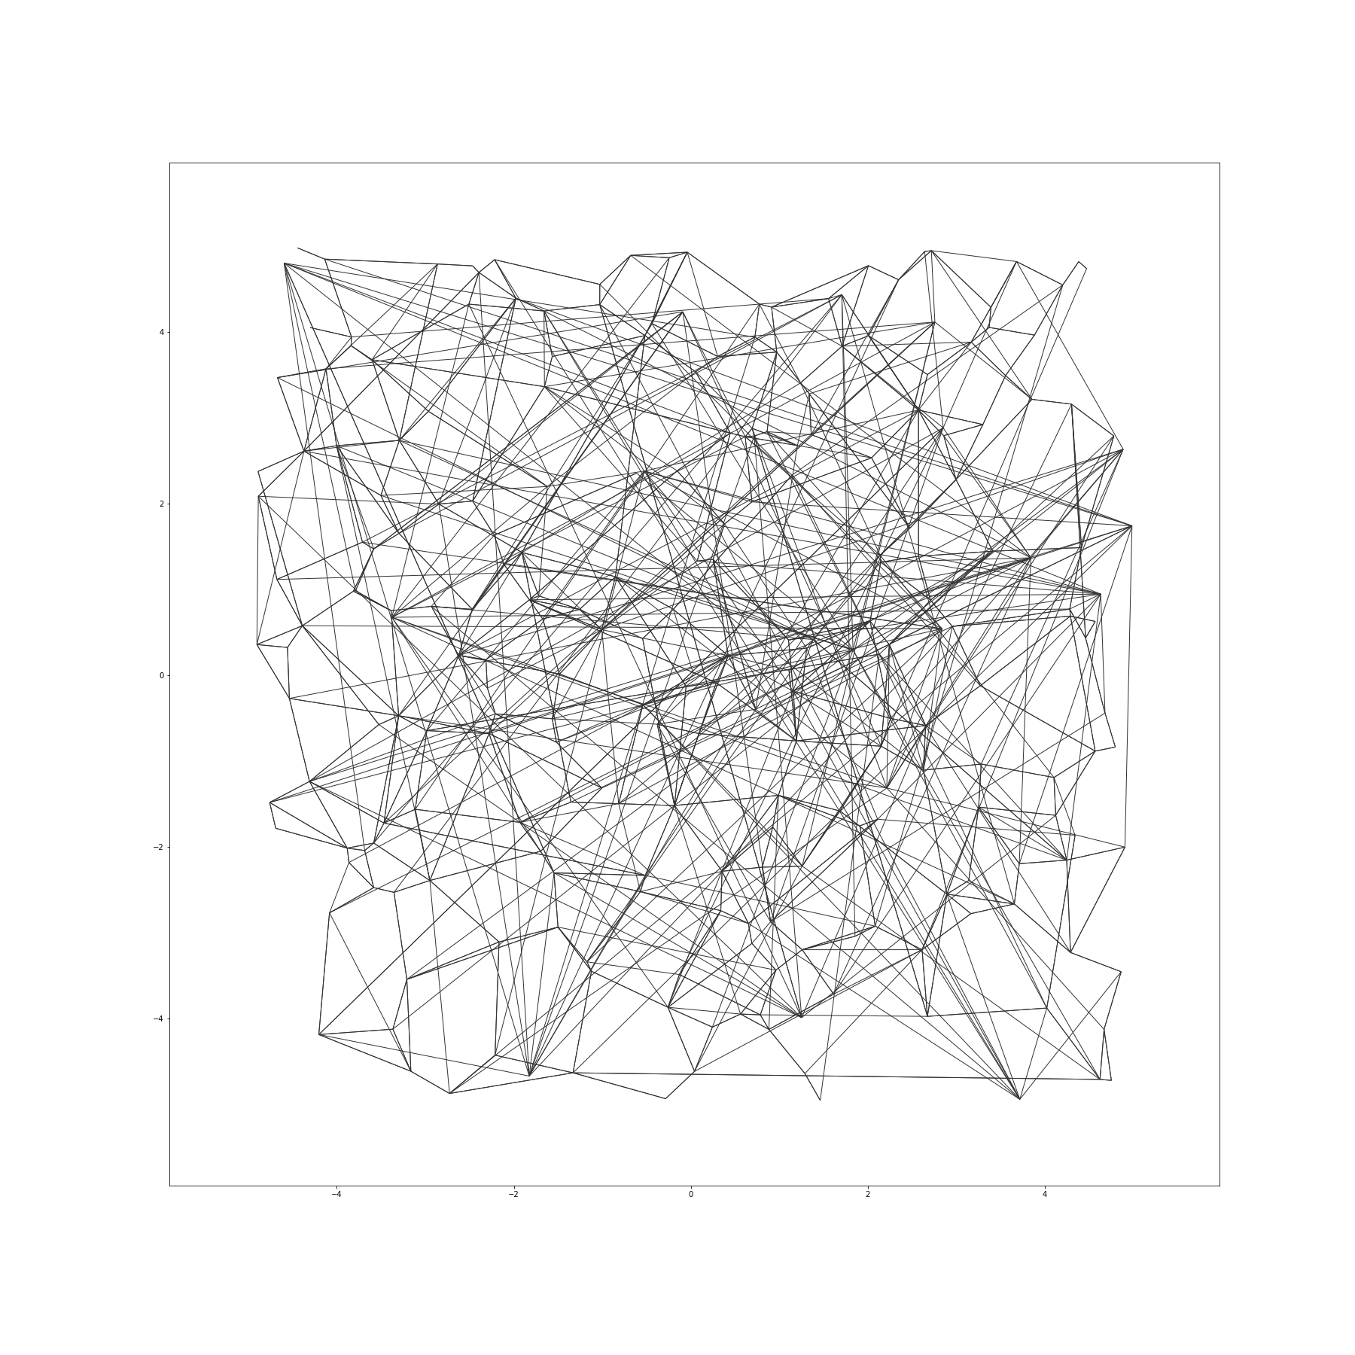
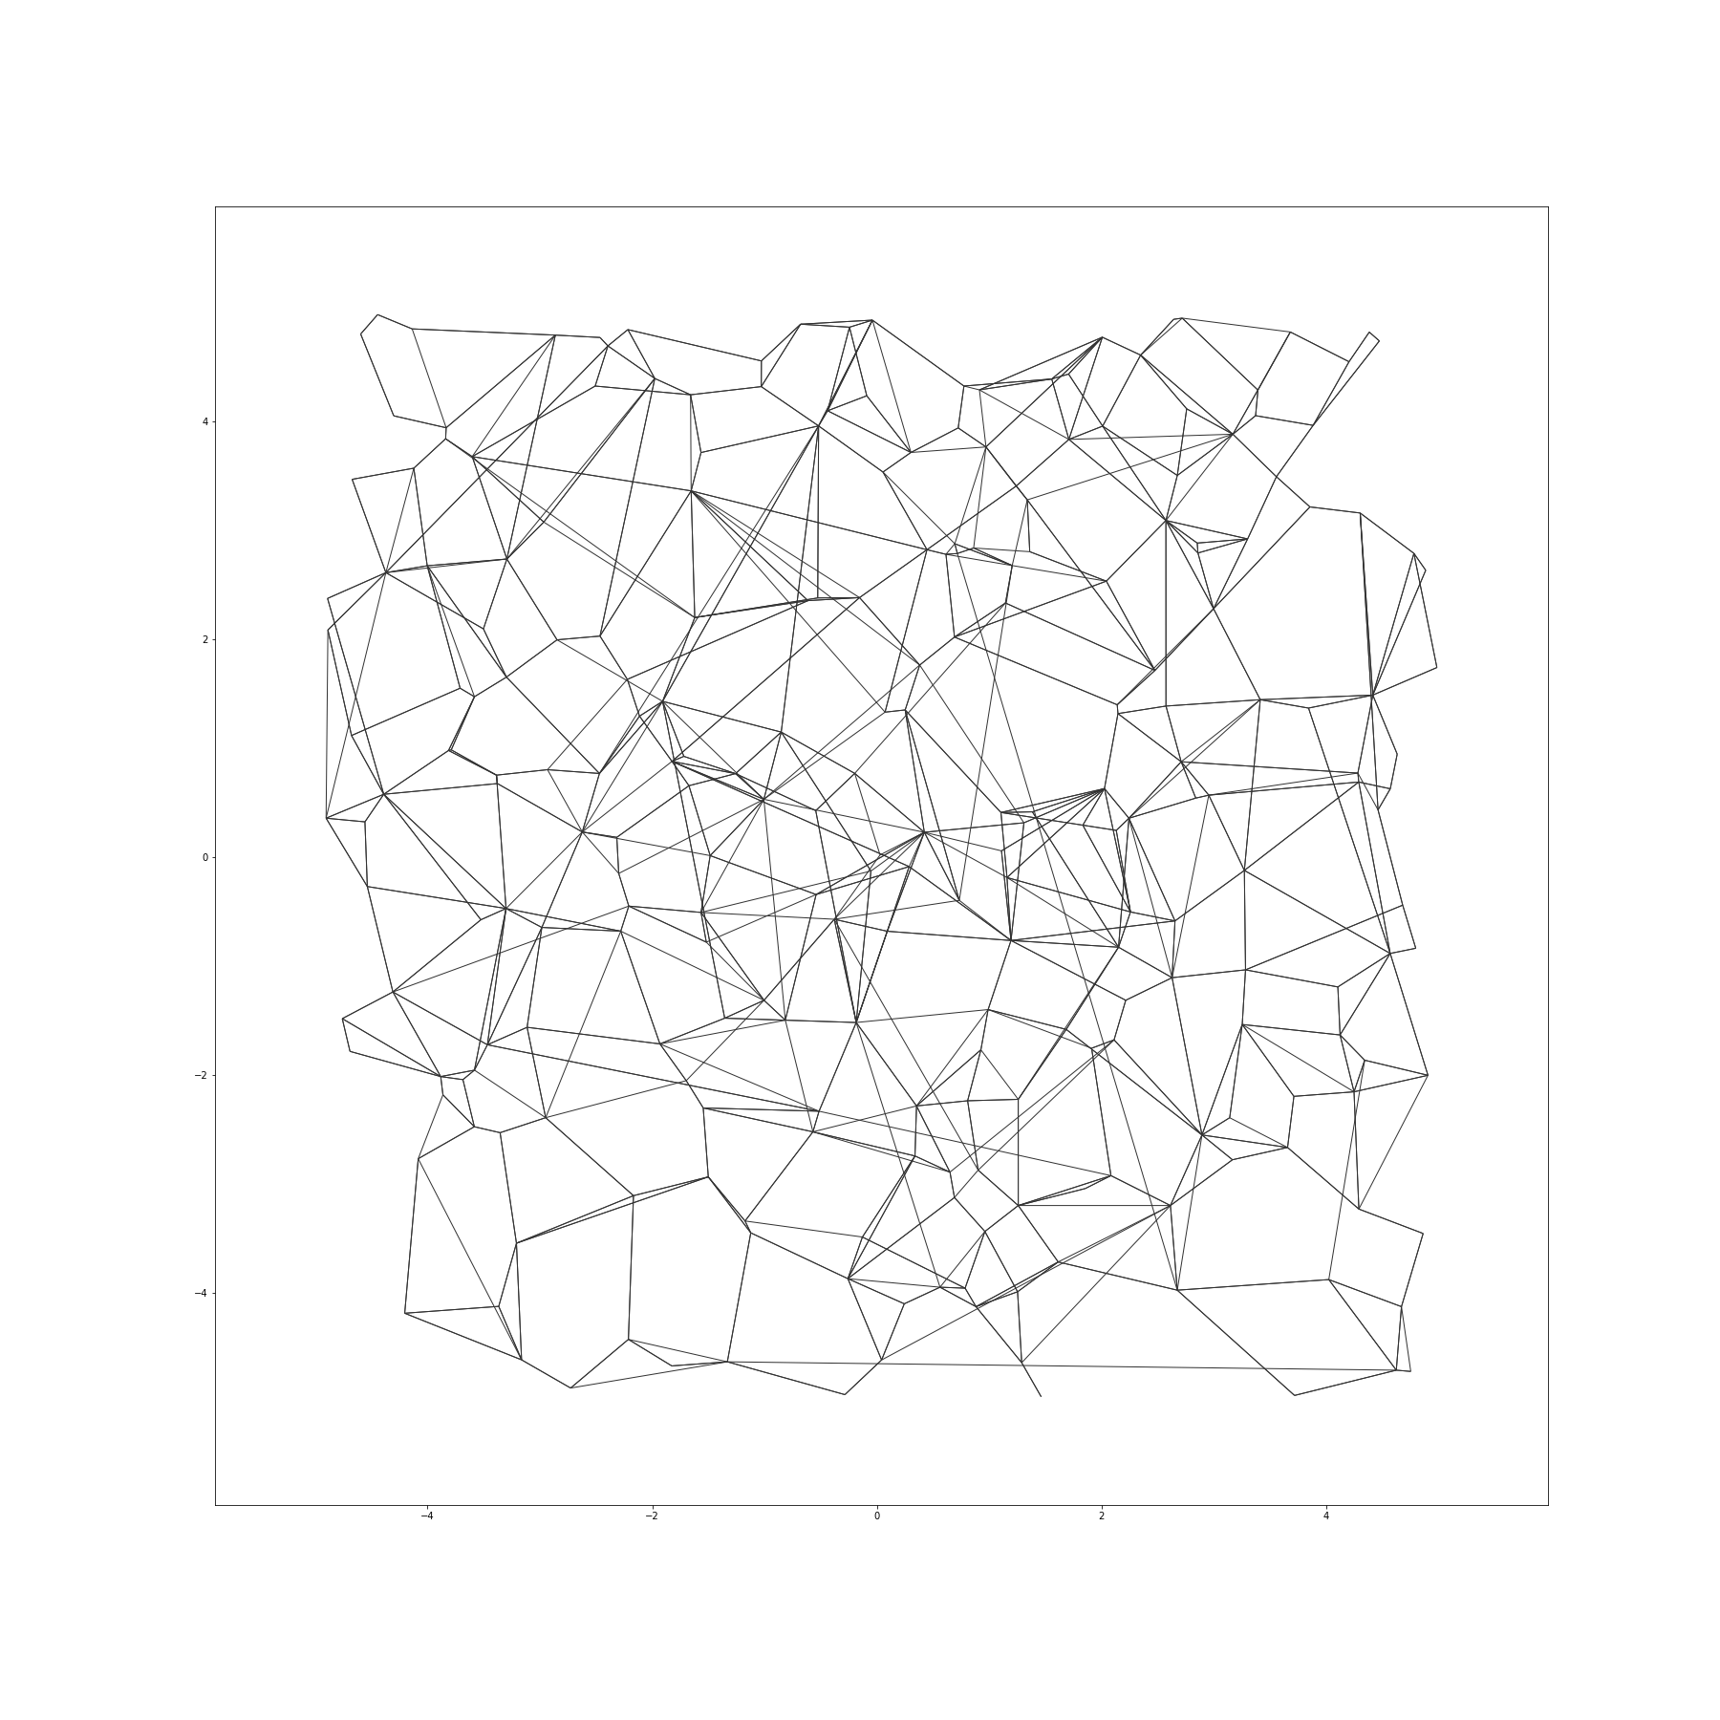
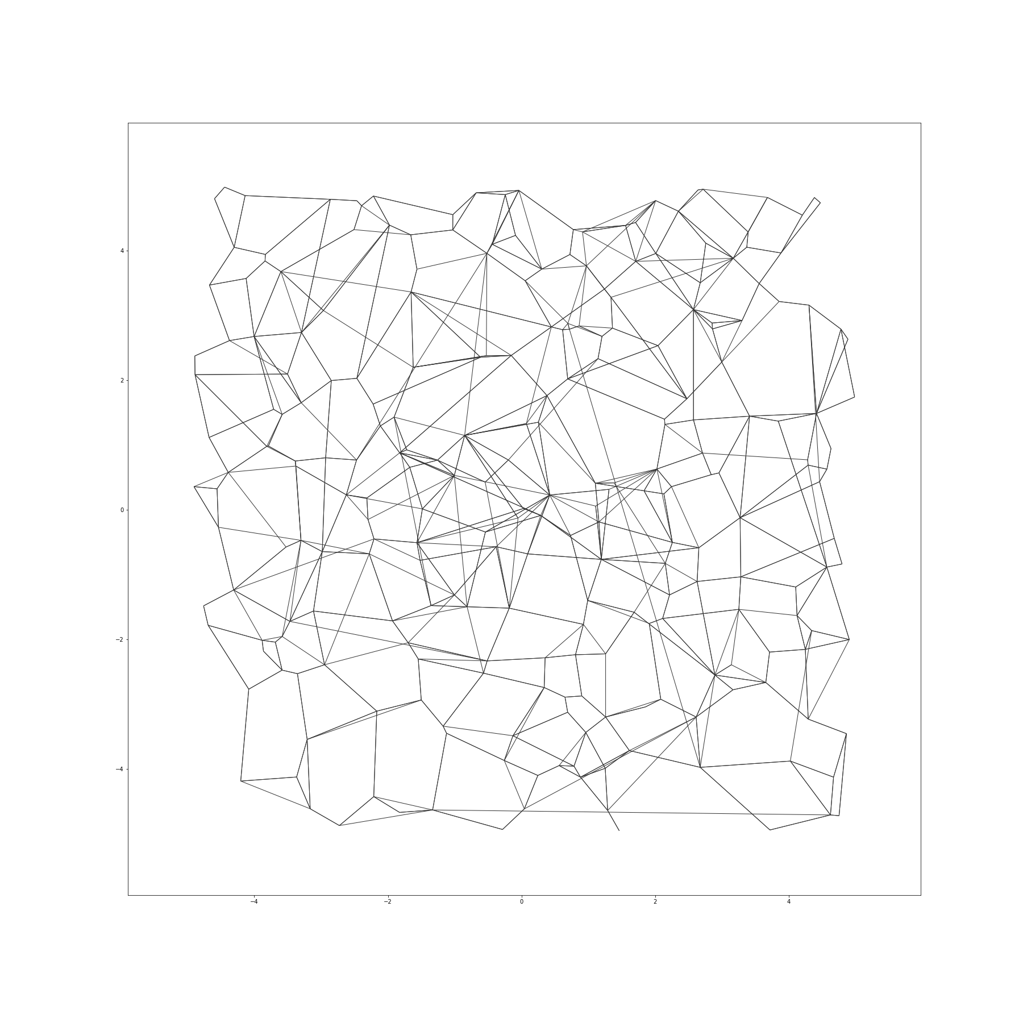
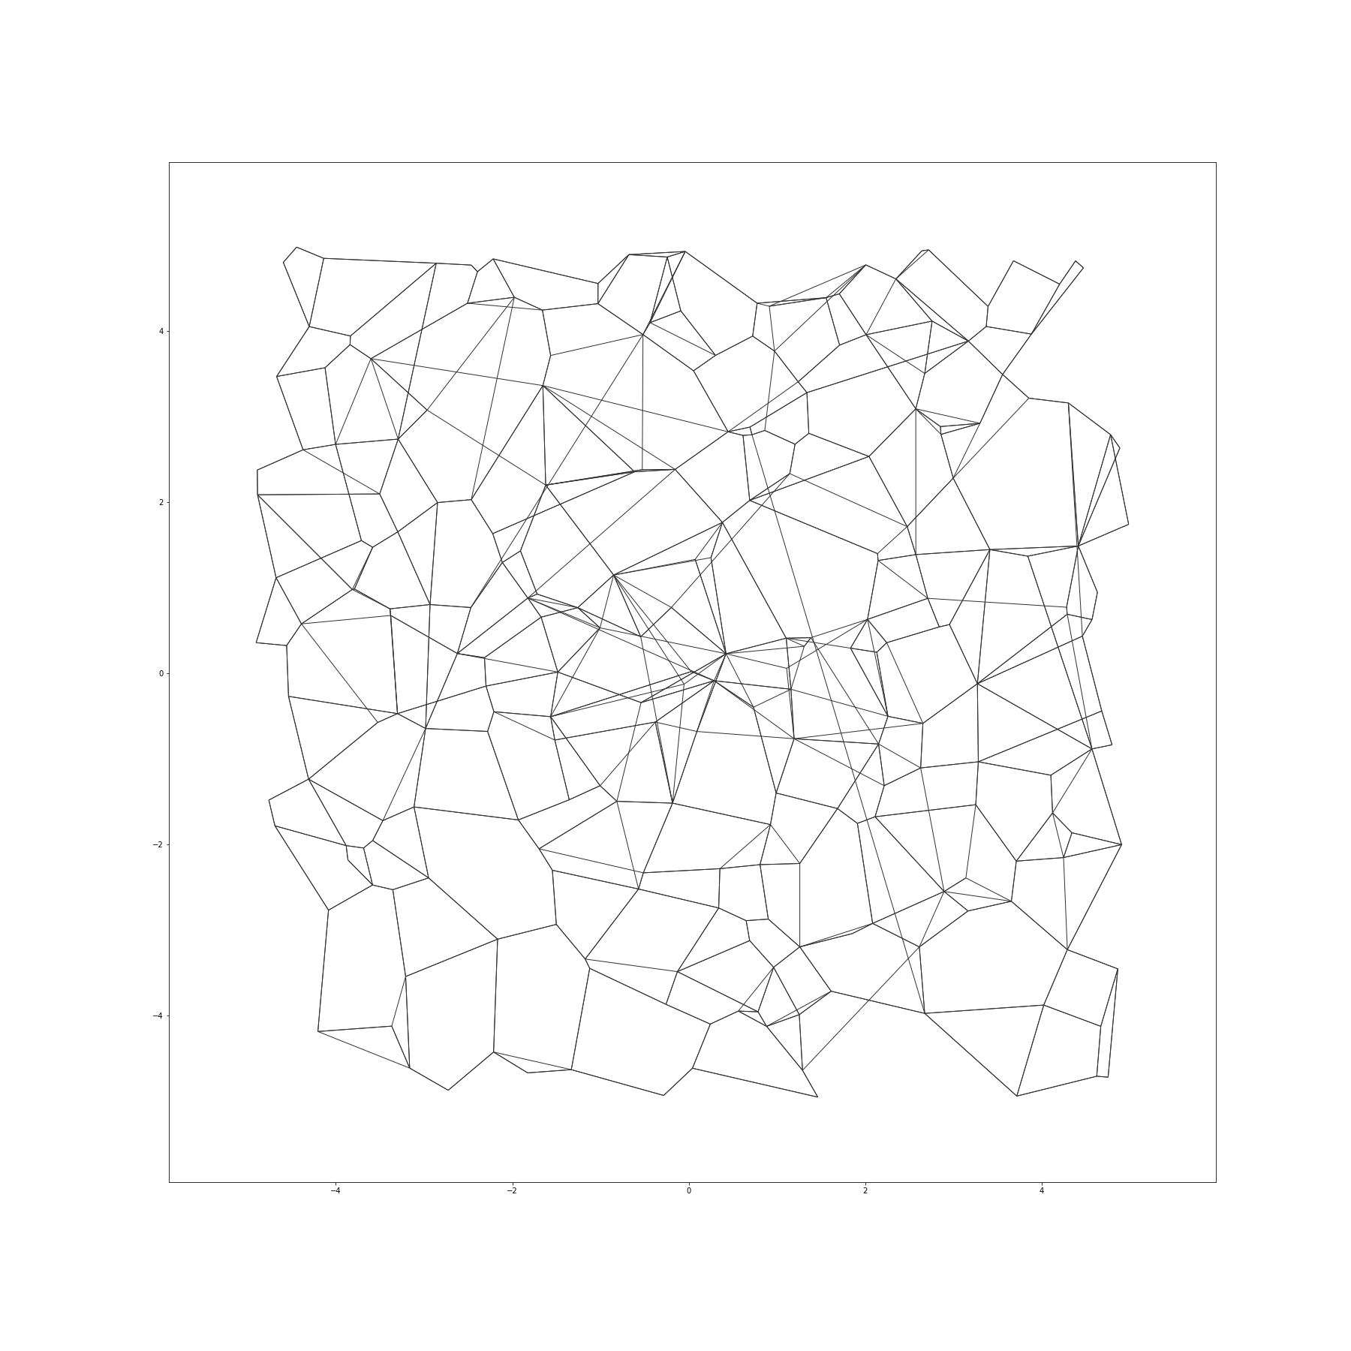
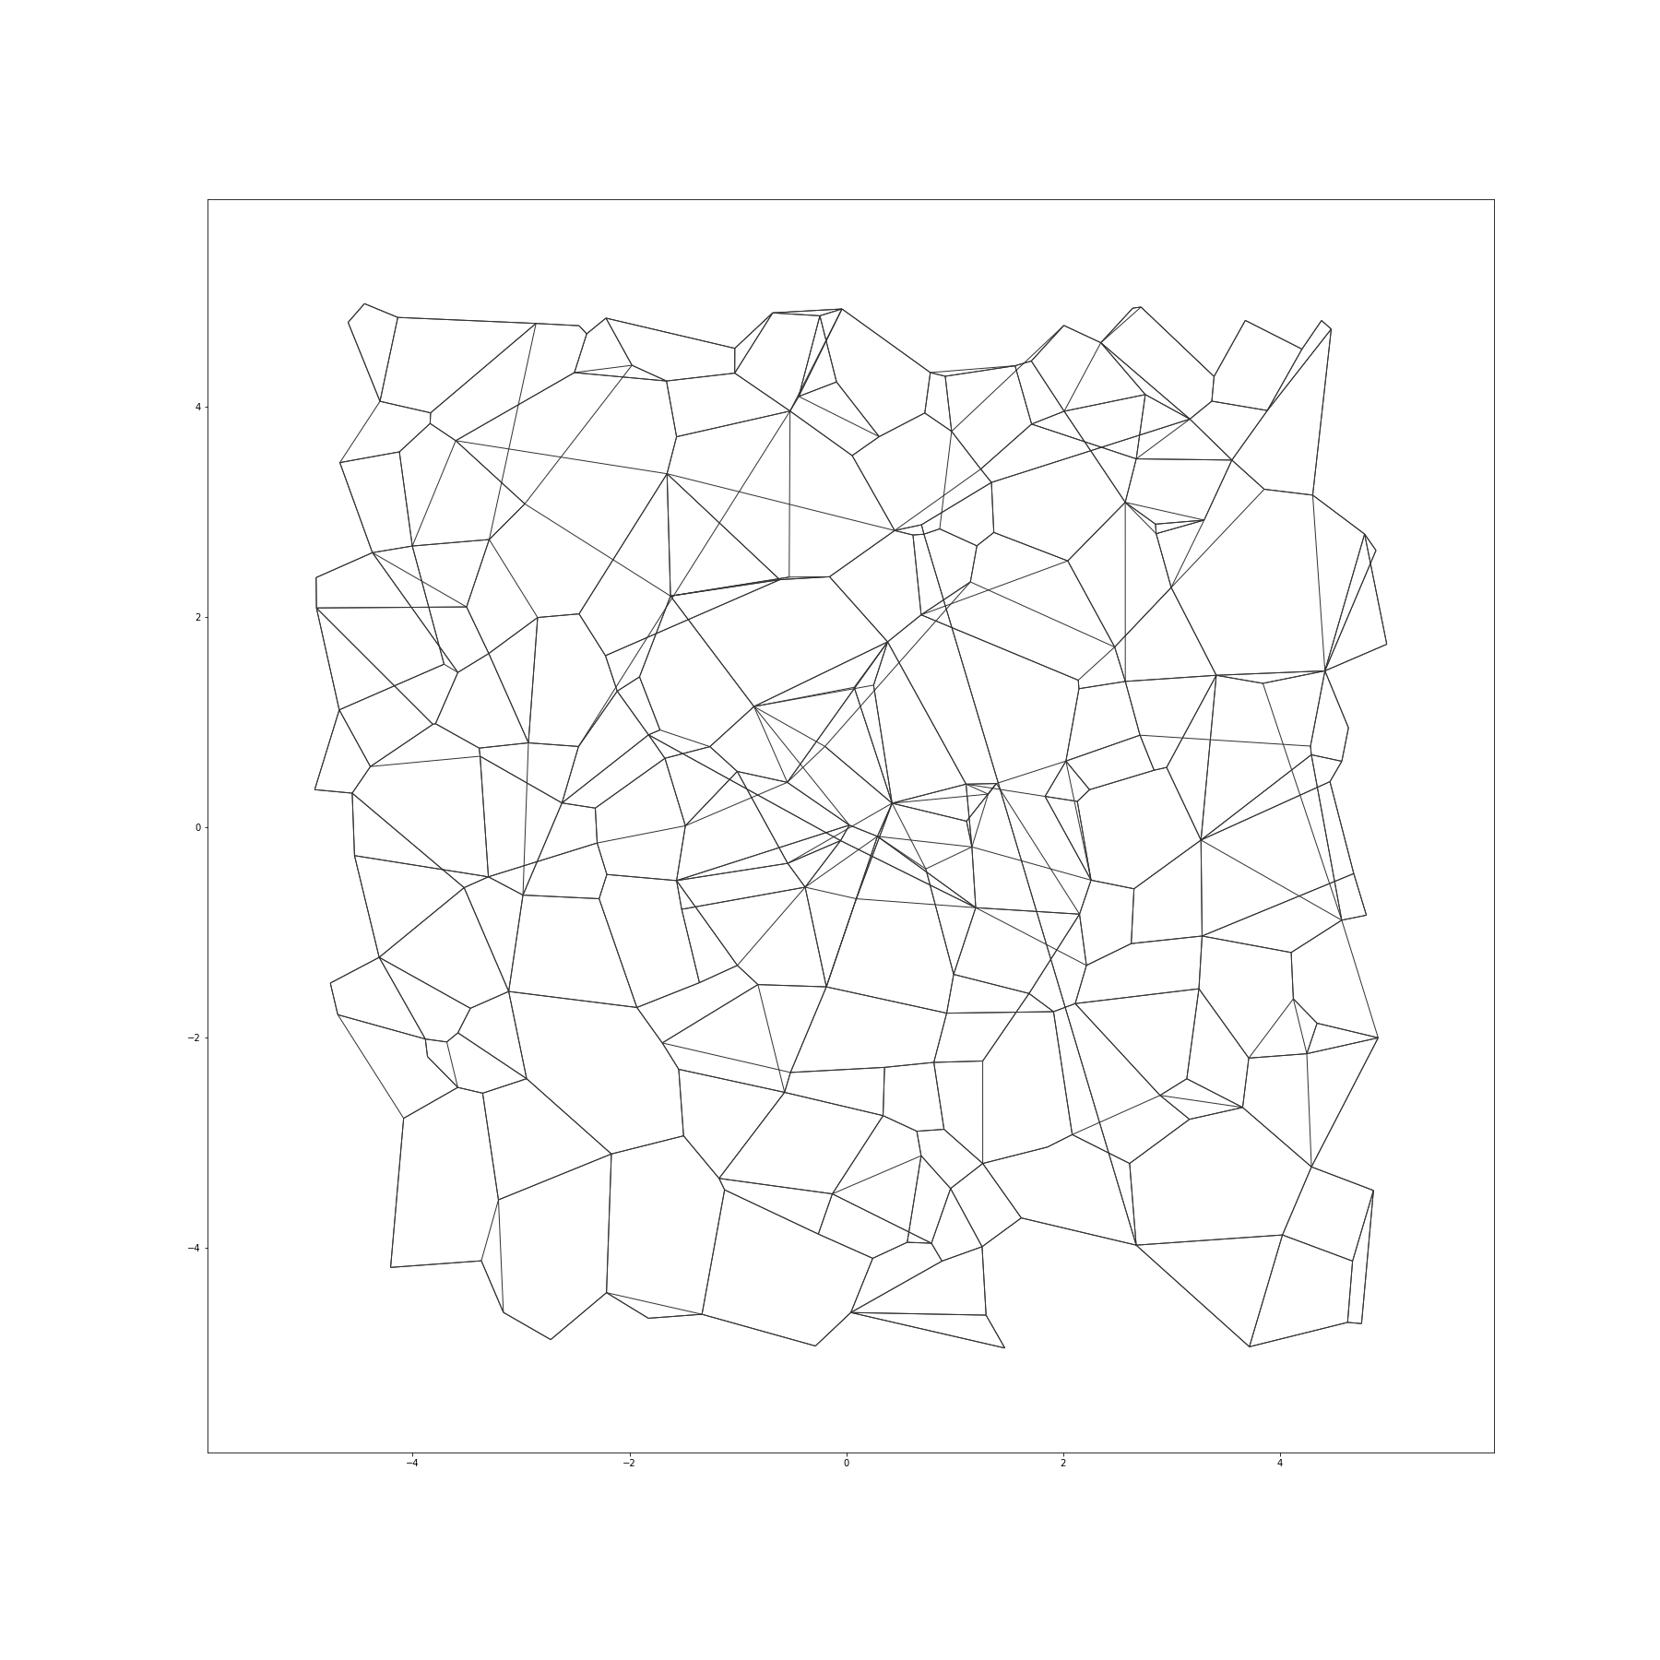
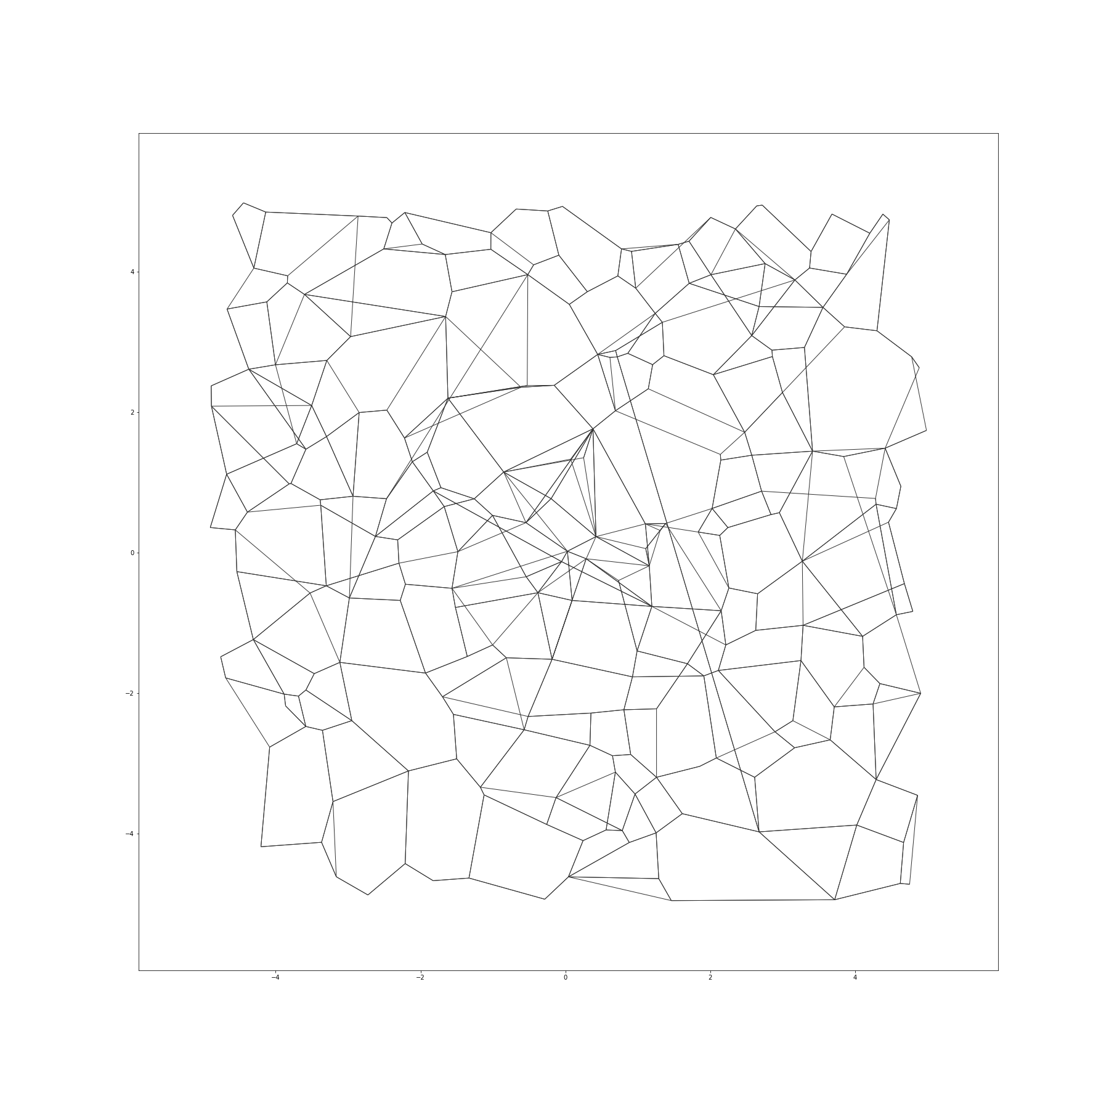
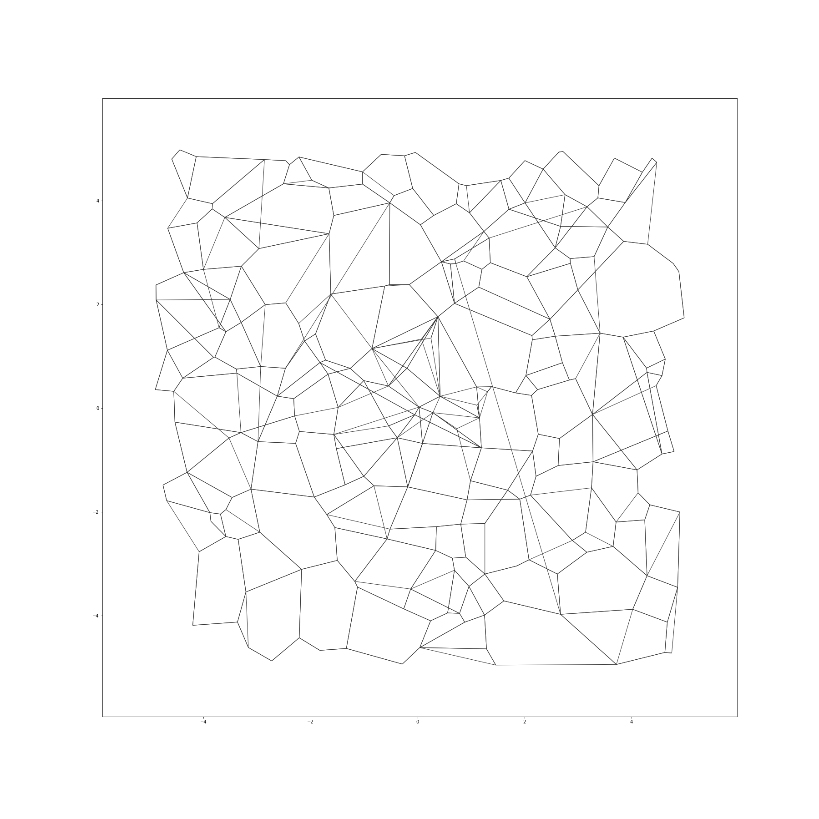
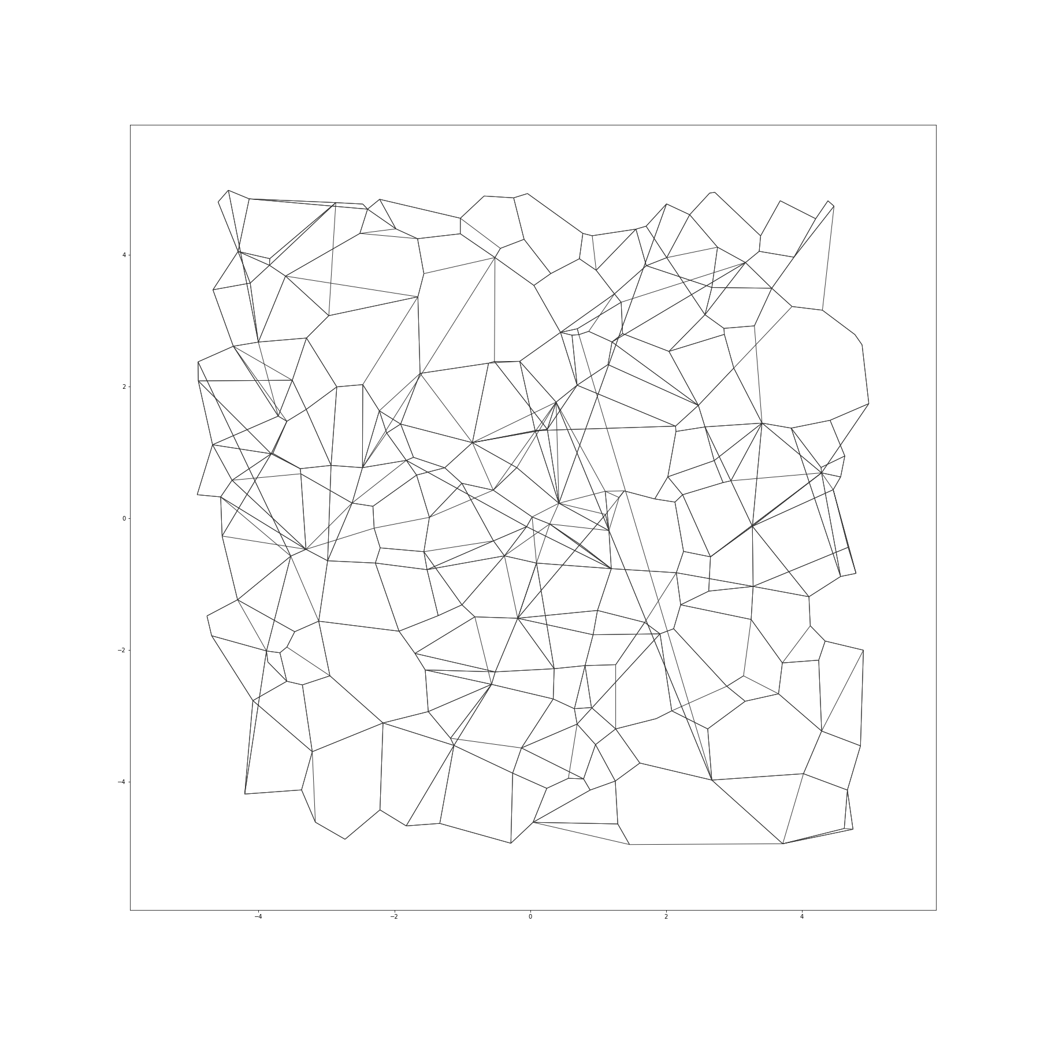
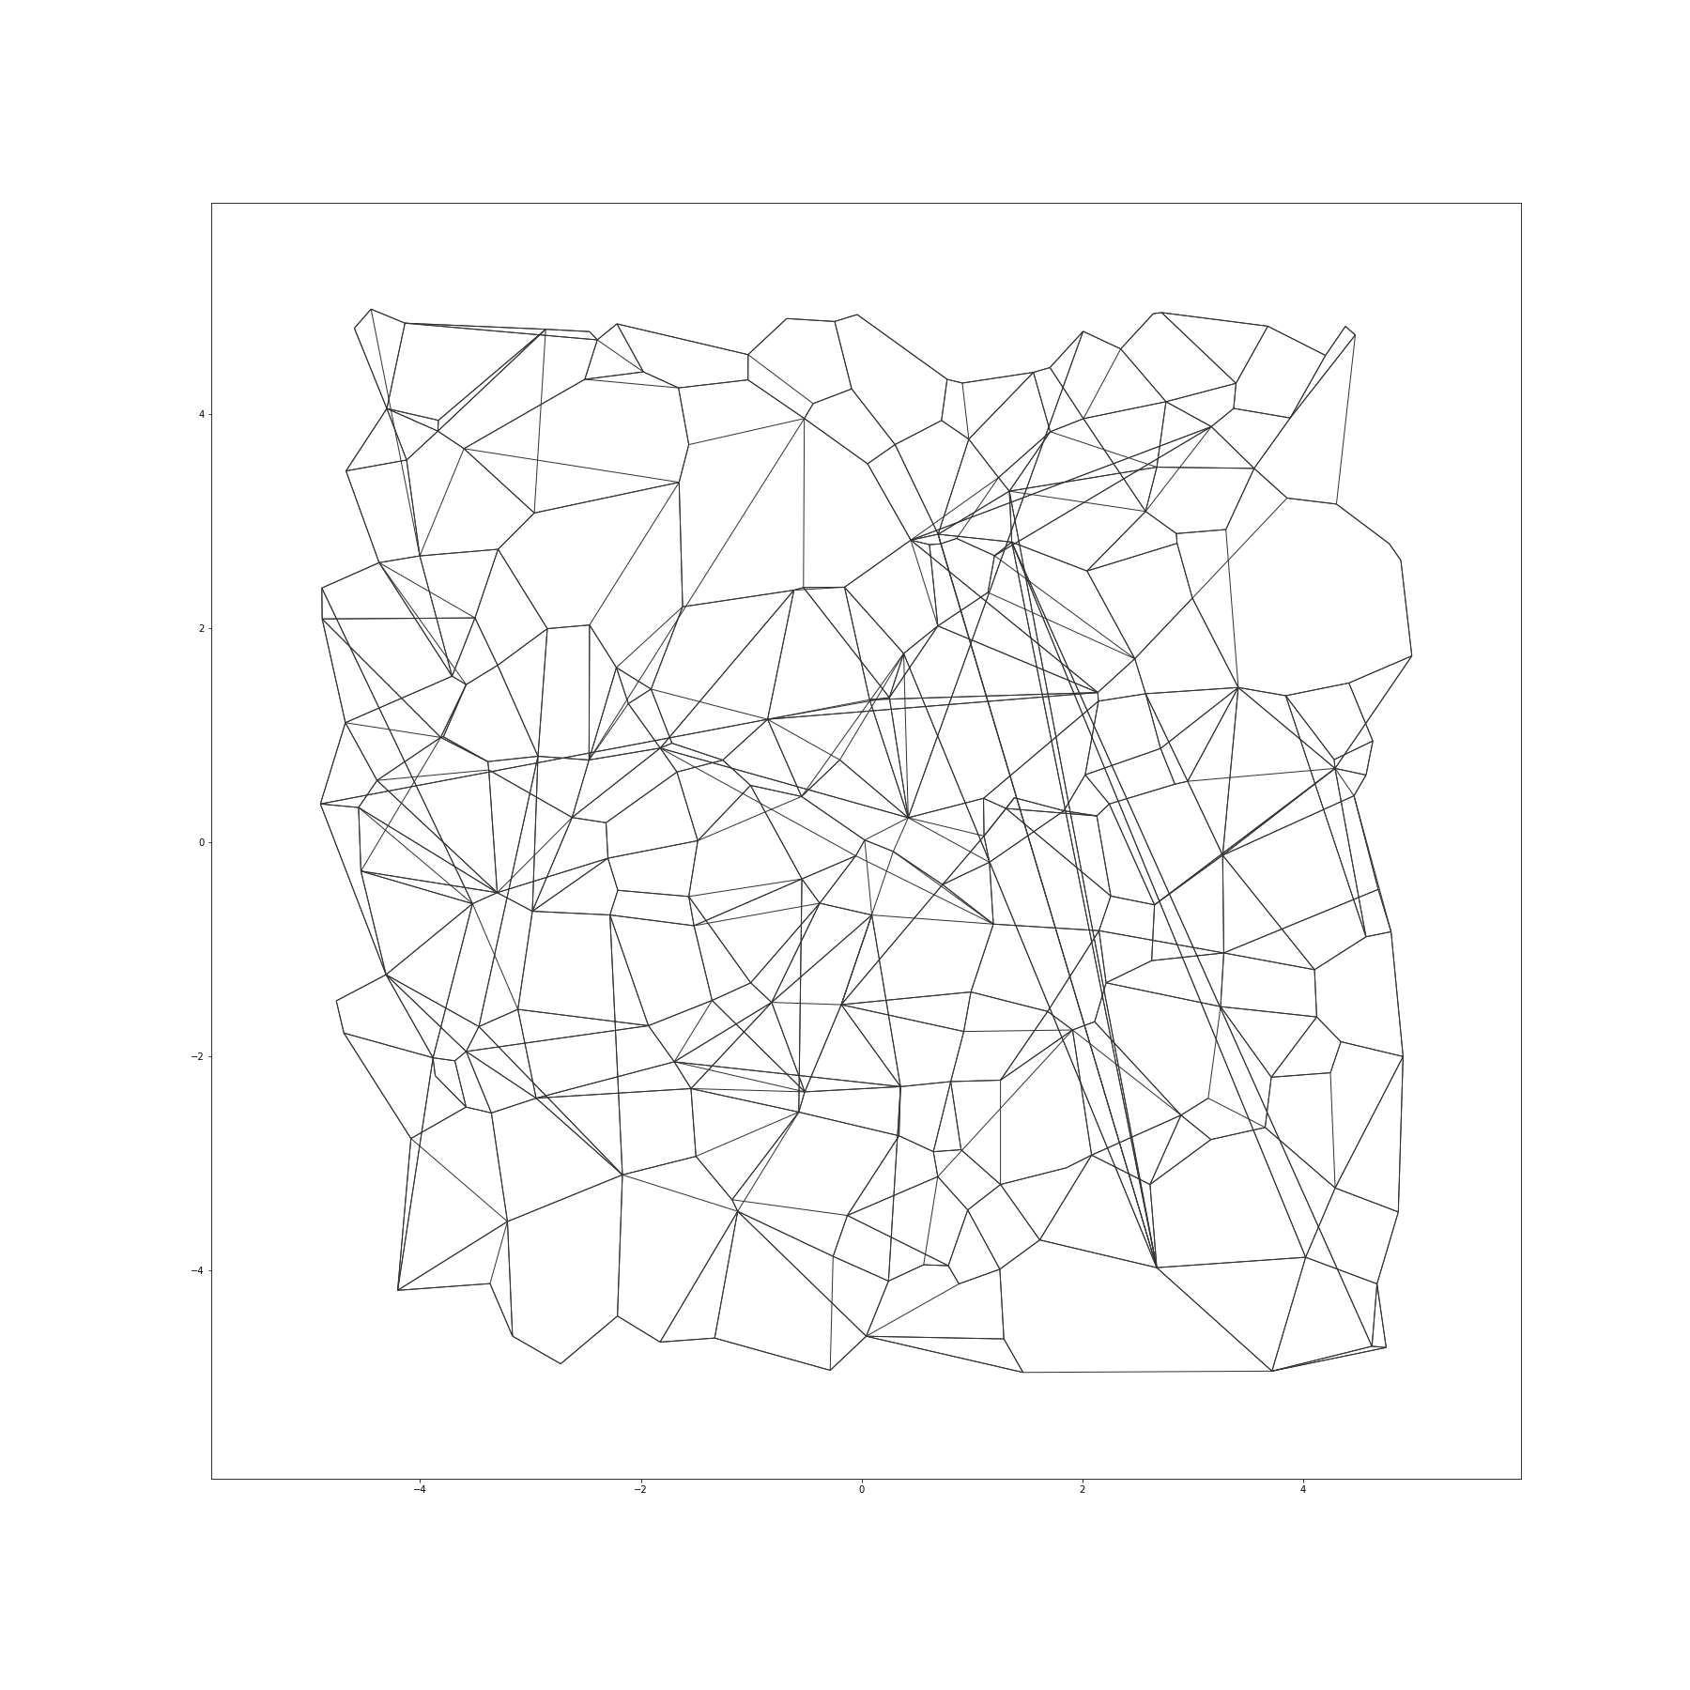
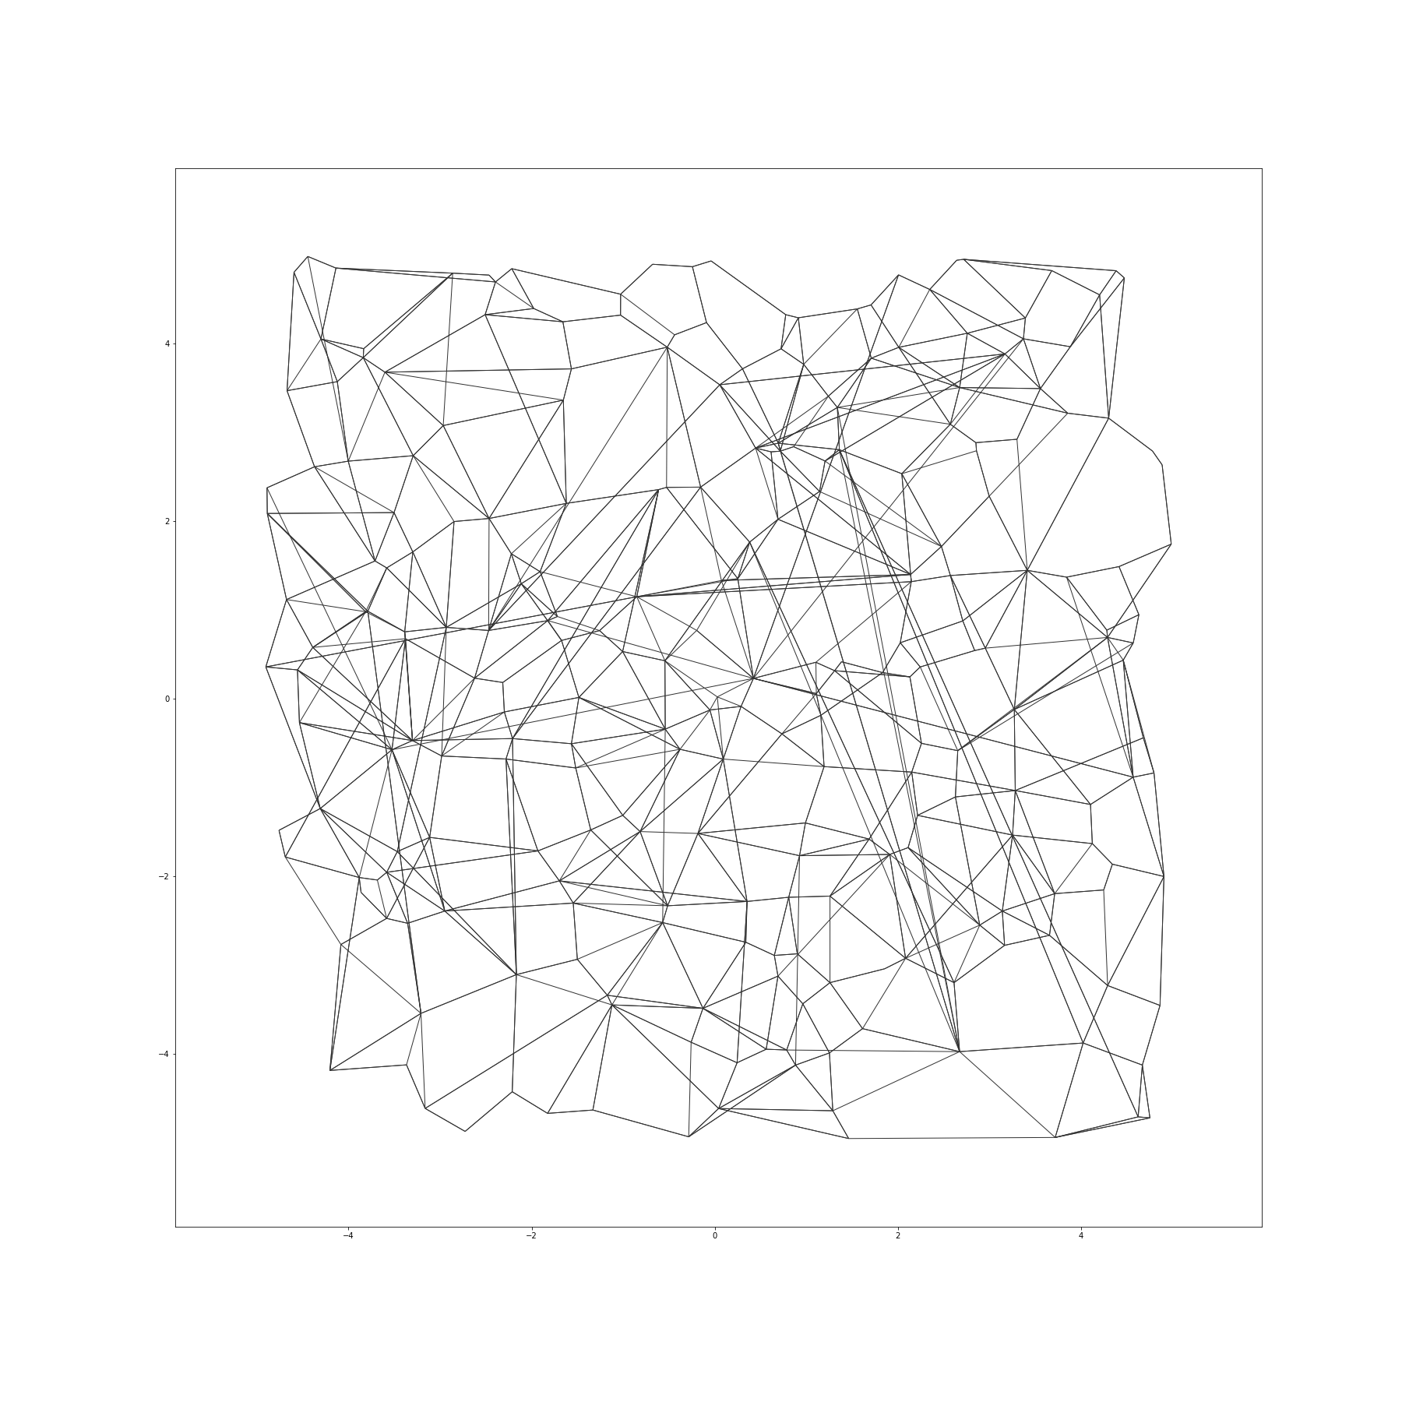
Illustration: Vamana in Action

Slide 14
How good is Vamana?
(a comparison with current-best algorithms HNSW and NSG)

Slide 15
Comparison of Vamana with In-memory Indices
1M points
128 dimensions
Image descriptors
1M points
960 dimensions
Image descriptors
1M points
96 dimensions
DNN encoding
For a fixed budget on indexing time
HNSW has largest index size, Vamana and NSG are much smaller

Slide 16
Our Results
DiskANN and Vamana: a simple, intuitive graph algorithm algorithm that can build and serve a DiskANN index of 1B points in 100s of dimensions on machine with 64GB RAM, and get ~95 recall-10@10 with <5ms latency
FASTER IN-MEMORY SEARCH: Out-performs best-in-class algorithms such as NSG and HNSW
FASTER INDEXING: Indexes 2-3x faster than NSG with 3-4x fewer resources (no GPUs, etc.)
MORE SCALABLE: Enables a divide-and-conquer strategy to build indices over billion points, Enables storing index on SSD to search with low latency and high recall

Slide 17
Indexing billion points with Rand-NSG
If not, and you just have a 64GB RAM machine, you can still build a single index!
Idea: partition data using k-means with k=40
Send each base point to 2 nearest clusters (so we get overlapping clusters)
Build index for each cluster, and merge all of them to get good connectivity across overlapping regions
Maybe divide data into 20 shards using k-means and build index for each shard?
At query time, if you route query to only nearest shard, we incur loss of accuracy
If you send it to multiple shards (say 2 or 3), QPS drops by factor 2 or 3
If you have a large RAM (1-2 TB) machine with 16 cores,
you can just index 1B points on it in 2-3 days

Slide 18
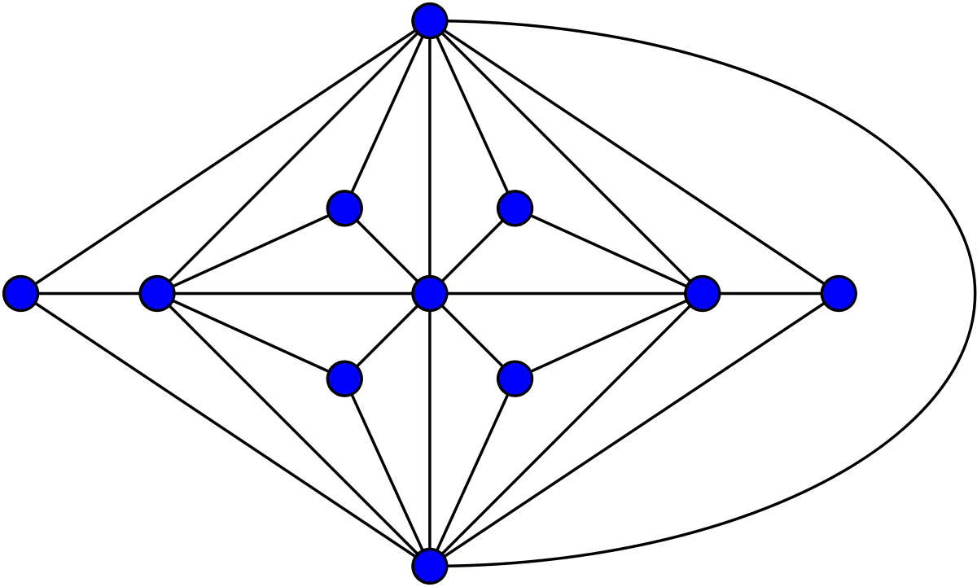
Merged- Vamana Illustration
Sending each base point to 2 clusters provides the necessary overlap
Cleanly avoids “boundary effects” which arise due to k-means partitioning

Slide 19
Our Results
Vamana : a simple, intuitive algorithm which can build and serve an index of 1B points in 100s of dimensions on a machine with 64GB RAM, and get ~95 recall@10 with 5ms latency
FASTER IN-MEMORY SEARCH: Out-performs best-in-class algorithms such as NSG and HNSW
FASTER INDEXING: Indexes 2-3x faster than NSG with 3-4x fewer resources (no GPUs, etc.)
MORE SCALABLE: Enables a divide-and-conquer strategy to build indices over billion points, Enables storing index on SSD to search with low latency and high recall

Slide 20
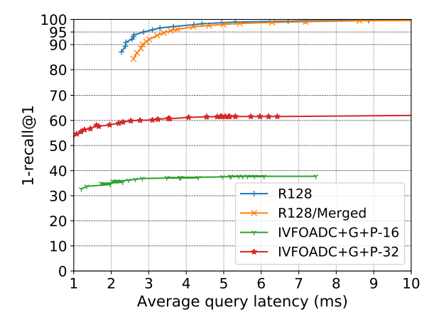
How does Vamana do on 1B size-data?

Slide 21
The DiskANN system for SSD-Based Search
In-memory:
Compressed coordinates of all points + BFS levels 1,2,3 from navigating node
On SSD:
For each node v store full precision coordinates of v + list of v's neighbors
Compressed coordinates are generated using a technique known as Product Quantization and let us approximately compute distances from query to the base points
In full precision, 1B points in 100 dimensions would consume 400 GB RAM, but we can achieve very good results by storing them as compressed coordinates totaling 32GB

Slide 22
BeamSearch: Searching on SSD-Resident Index
BeamSearch(k, q,W, Ls): k-(A)NNs of q with size Ls search list & Beam-width W
Initialize priority queue PQ of size Ls with navigating node n
Pick W closest candidates to q in PQ, fetch their full-precision coordinates and their neighborhoods and insert the neighborhood vertices into PQ
Re-rank PQ by doing approximate distance comparisons using compressed vectors and truncate PQ to size Ls
Iterate till all vertices are expanded and PQ does not change
Re-rank the final Ls vertices in PQ using full precision coordinates and output top K
W disk accesses

Slide 23
Round-trips to SSD: Comparison with other graph algorithms
Search Parameters
PQ size, Ls=30
Beam-width, W = 4

Slide 24
How does Vamana do on 1B size-data?
SIFT1B
64GB DRAM
16 cores / 16 threads
2x Samsung 960Evo RAID0
QPS : 5548
Latency : 2.86ms
Recall@1 : 95.00
QPS : 3206
Latency : 4.96ms
Recall@10 : 95.00

Slide 25
Summary
A simple, intuitive algorithm which can build and serve an index of 1B points in 100s of dimensions on a machine with 64GB RAM, and get 95 recall@10 with 5ms latency
Best-in-class for in-memory search
Indexing time/memory also best-in-class
Scales to billions of points on single machine with SSD

